Slide 1
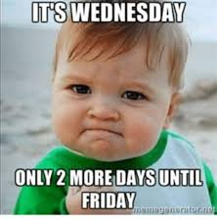
Happy Wednesday
Take your name tag
Check-in

Slide 2

First Exam
Any question?
Notes:
I am very satisfied with your results
General thoughts?
Second exam will be very similar to the first one. However, it might be a little more challenging because we will cover more math and regression in the second half of this class
I have also synced your iclicker points to your canvas. So you should be able to know your current grade.

Slide 3

Feedback
How was the exam?
Extremely hard
Manageable
Easy peasy

Slide 4

Feedback
Did you make your own notes?
Yes
No

Slide 5

iClicker Question
Response error is when you suppose to ask all graduate students for their annual salary, but only those who are happy with their salary will answer
True
False
Notes:
Nonresponse Error
Error that occurs when an individual provides an inaccurate response, consciously or subconsciously, to a survey item

Slide 6

iClicker Question
Recording error is when you make mistakes while editing, coding data
True
False
Notes:
Office error
Mistakes made by humans or machines in the process of recording respondents’ communication- or observation-based data

Slide 7

iClicker Question
You’ve conducted an online survey, attempting to contact 500 people; the 500 sample elements have been classified as follows:
Completed surveys: 250
Refusals: 200
Number of not-at-home: 50
20%
50%
90%
Notes:
50

Slide 8
Calculating Response Rates
The number of completed interviews with responding units divided by the number of eligible responding units in the sample
$response rate=\frac{\left\{number of completed interviews with responding units\right\}}{\left\{number of eligible responding units in the sample \right\}}$
Online and Mail Surveys (no eligibility requirement)
$RR=\frac{\left\{number of usable questionnaires\right\}}{\left\{number of contacts attempted −number of wrong addresses\right\}}$
Telephone Surveys (no eligibility requirement)
$RR=\frac{\left\{number of completed interviews\right\}}{\left\{number of completed interviews+number of refusals+number of not−at−homes\right\}}$
Mail Surveys, Online Surveys, and Telephone Interviews (with eligibility requirement)
$E\%=\frac{\left\{number of completed interviews\right\}}{\left\{number of completed interviews+nubmer of ineligibles\right\}}$
$RR=\frac{\left\{number of completed interviews\right\}}{\left\{number of completed interviews+E\%(number of refusals+nubmer of not−at−homes)\right\}}$

Slide 9
iClicker Question
Regardless of the variable distribution, the sampling distribution of its mean will always to normal (i.e., Gaussian) distribution
True
False

Slide 10




Chapter 16: Data Preparation for Analysis
Notes:
I understand that you still have 1 more week to collect your data. But in the meantime, we will learn how to prepare data for analysis.

Slide 11

Learning Objectives
Explain the purpose of the editing process
Define what coding is
Describe the kinds of information contained in a codebook
Describe common methods for cleaning the data file
Discuss options for dealing with missing data in analyses

Slide 12
Primary Tasks in the Editing Process
Editing: the inspection and correction of the data received from each element of the sample (or census)
Convert all responses to consistent units
Assess the degree of nonresponse
Where possible check for consistency across responses
Look for evidence that the respondent wasn’t really thinking about his or her answers
Verify that branching questions were followed correctly
Add any needed codes
Notes:
Qualtrics should be able to edit and process most of the responses for you expect for special cases.
But I think it’s still important to know how Qualtrics does this so that if you use another software, you can understand the underlying process
You also have to assess the degree of nonresponse. At first, we estimate the nonresponse rate in order to derive at our ask sample. But now, after collecting data, we know the exact nonresponse rate. Hence, we can easily calculate this number. If we have a high non-response rate, then we should be concerned because there might be questions in our questionnaire that deter people from answering. Or we might ask the wrong population to answer our questionnaire, they might not have the information that we need.
Then, we can check if there is consistency across responses. For example, if you receive a survey that all the answers are A, which is known as straightlining. Then you have to manual remove that survey, because it’s likely that he or she did not answer it consciously or put the right information down.
I know that most groups have branching questions, then you have to check whether it was followed correctly, by looking at your answer sheet.

Slide 13
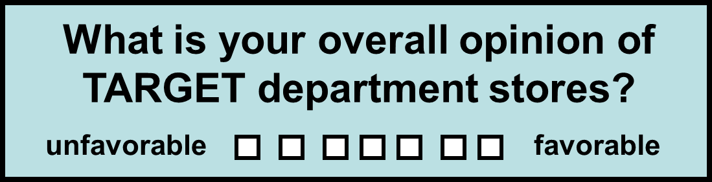
Coding Closed-Ended Items
Coding: The process of transforming raw data into symbols (usually numbers)
(Typical coding: 1 2 3 4 5 6 7 )
Notes:
So you see this type of question before, but we can’t analyze boxes,
We have to transform raw data into numbers such as Likert scale to a number scale, and you also have to know your baseline.
In this case your baseline is unfavorable.

Slide 14
Coding Closed-Ended Items
How did you learn about Brown Furniture Company? (check all that apply)
newspaper advertising
radio advertising
billboard advertising
recommended by others
drove by store
other: _______________
TYPICAL CODING:
6 different variables
(1 if checked; 0 if not)
(1 if checked; 0 if not)
(1 if checked; 0 if not)
(1 if checked; 0 if not)
(1 if checked; 0 if not)
(1 if checked; 0 if not)
Notes:
Another example is that your respondents can check multiple boxes, then you have to each variable corresponds to each box,
Example:

Slide 15
Coding Open-Ended Items
Factual open-ended items seeking concrete responses are relatively easy to code
Numeric answers are typically recorded as given by the respondent, while other types of responses are given a specific code number
Example
(1): In what year were you born? (code year)
(2): how many times have you eaten at Streeter’s Grill in the last month? (code number)
(3) Name the first 3 coffee shops located in Tampa that come to mind (code as 3 separate variables; assign numbers to represent each coffee shop mentioned)

Slide 16

Coding Open-Ended Items
Exploratory open-ended items seeking less structured responses are much more difficult to code
Example:
In your own words, give us 2 or 3 reasons why you prefer to leave the state after graduation
Notes:
Ask how might you code this question

Slide 17
Process for Coding Exploratory Open-Ended Questions
Identify usable responses
1
Develop categories for responses
2
Sort responses into categories, using multiple coders; compare results
3
Assess the degree of agreement between coders (inter-rater reliability)
4
Notes:
So here is the process for coding exploratory open-ended question
Open example for students
https://bookdown.org/mike/marketing_research/qualitative-research.html

Slide 18
Cleaning the Data
Blunder: An error that arises during editing, coding, or data entry
Blunders are usually due to researchers' carelessness
How to identify blunders:
Run frequency analysis on all variables
Check a sample of questionnaires against the data file
Double-entry of data (preferred)
Notes:
When we transcribe raw data into our desired format such as number or categories, we might encounter office error, which is also known as blunder.
There are several ways to identify this mistake,
You can run frequency analysis on all variables.
Say that you expect your answer to be 0 and 1 only, but when you run your frequency analysis, you find out that there is one person answer 3, then you know that either you have to remove that response, or you have to double check to see whether you input data incorrectly
If you have limited resources, and you can’t hire another coder, then you can randomly select a sample the data file and check it with the actual questionnaire answers.
And if you have more resources, and you can hire another coder, then have two coders independently code the questionnaire, and run inter-rate reliability to check where the two might differ

Slide 19

Handling Missing Data
Item Nonresponse: A source of error that arises when a respondent agrees to an interview but refuses, or is unable, to answer specific questions
If a particular case has a significant amount of item nonresponse, it should probably be eliminated during the editing process
This Photo by Unknown Author is licensed under CC BY-SA-NC

Slide 20
Alternative Strategies for Handling Missing Data
Eliminate the case with the missing item(s) from all further analyses
1
Substitute values for the missing items
2
Contact the respondent again
3
Notes:
Alternatively, we can have the following strategies for handling missing data
The first strategy is rather easy but also comes at a great cost. You can eliminate the whole case with the missing items from all analyses
But the cost is that you lose the whole observation. However, a more serious issue is whether your data are missing at random or missing not at random.
If it’s missing at random, then you don’t have to worry much. You just don’t have enough power to do analysis, but your inference is still correct or unbiased.
We will talk more about power in later chapters.
But if your data are not missing at random. Then you have a problem, which is selection bias. Just like the salary case, only those who answered the survey will be satisfied with their salary, and you can only observe those that answered. Hence, your inference about the average salary can be positively biased as compared to the true population parameter.
Another strategy for handling missing data is to substitute values for the missing items. This method is called imputation
https://bookdown.org/mike/data_analysis/imputation-missing-data.html
(show the book)
There are so many methods to do imputation, such as taking an average from the other observations, and impute it in the missing place
The last strategy is to contact the respondents again, assuming that you do have their contact information.
This is rather an obvious one.

Slide 21
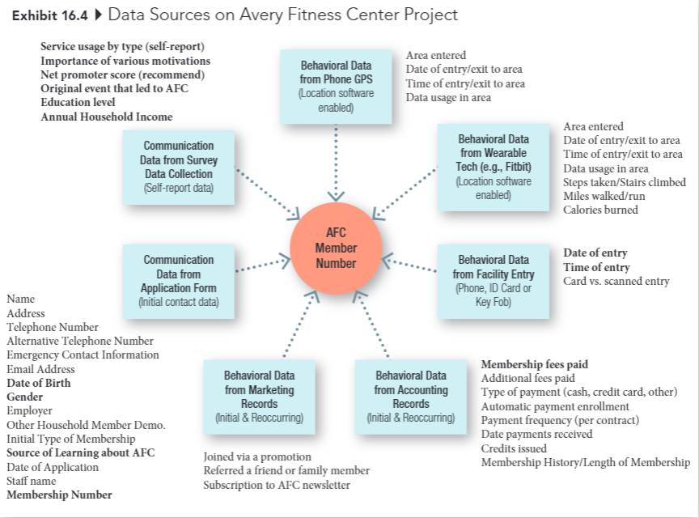
Avery Fitness Center Project
Notes:
Now we go into detail of the Avery fitness center project
We collect data for every AFC member,
So think of every member will occupy one row in the data frame,
In each row, we have data based on location, ID, phone, initial contact data, self-report data

Slide 22
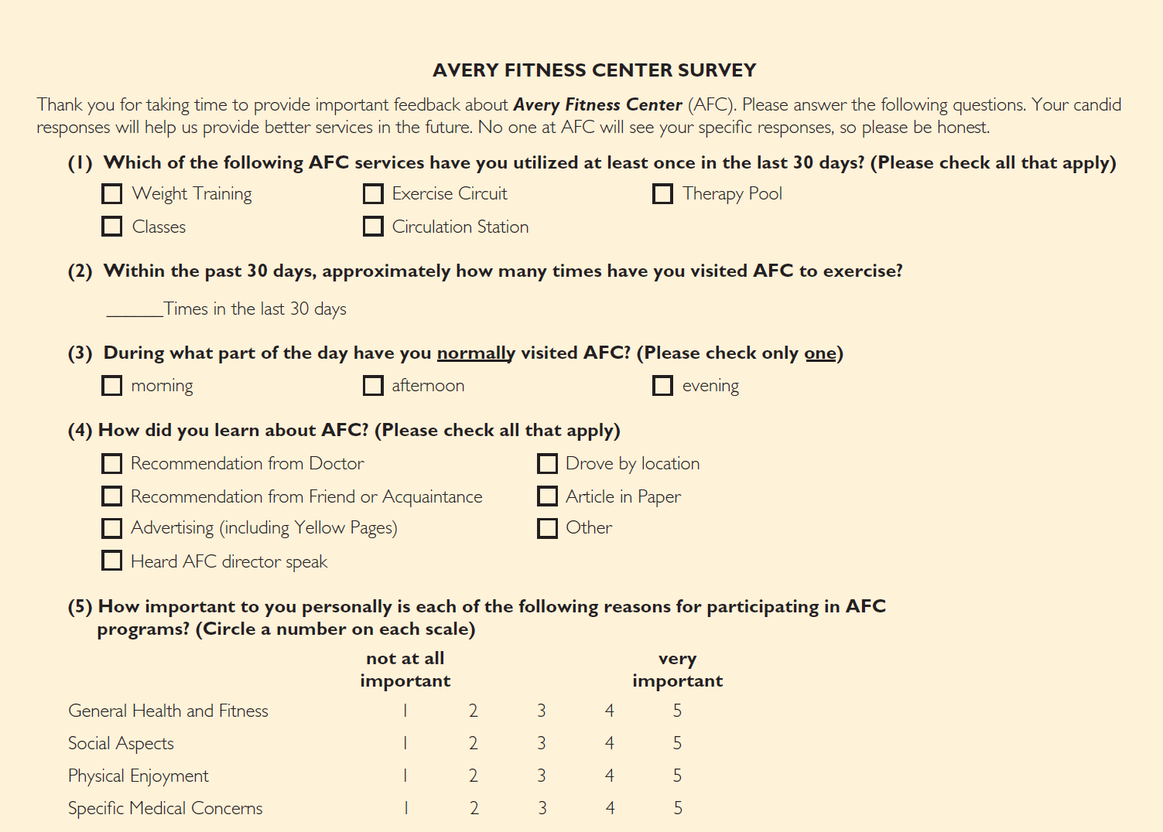
Avery Fitness Center Survey
Notes:
This is the survey that AFC used to collect data on their members
Go into questions

Slide 23
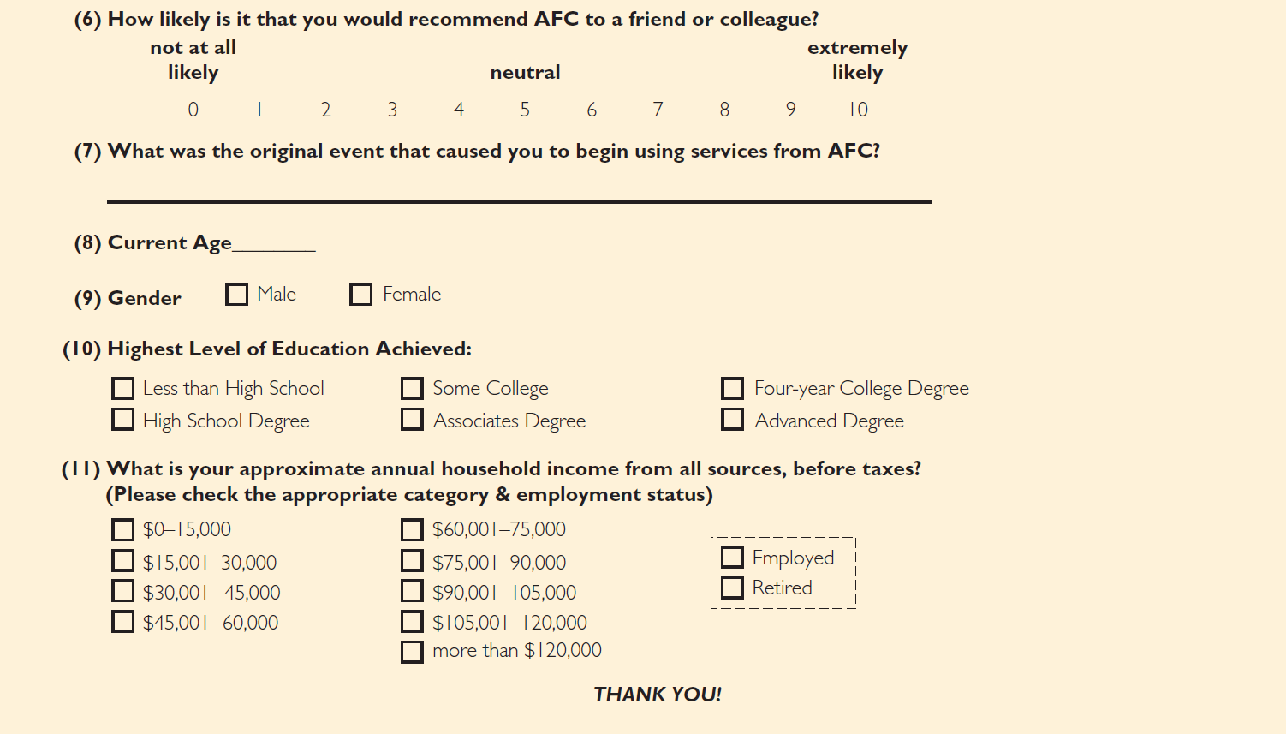
Avery Fitness Center Survey (cont.)

Slide 24

Developing a Codebook
Codebook: A document that contains explicit directions about how data from data collection forms are coded in the data file
Notes:
After getting raw data from the customers or respondents in your case, we have to have internal codebook.
Which is a document that contains explicit direction about how data from data collection forms are coded in the data file.
Other classes require students to turn in the codebook, but I think you can have one internally on how to code your data. I believe as long as your group understand how the data were inputted and then analyzed. That’s all what matters, just like when you work for companies, they would care more about the results

Slide 25
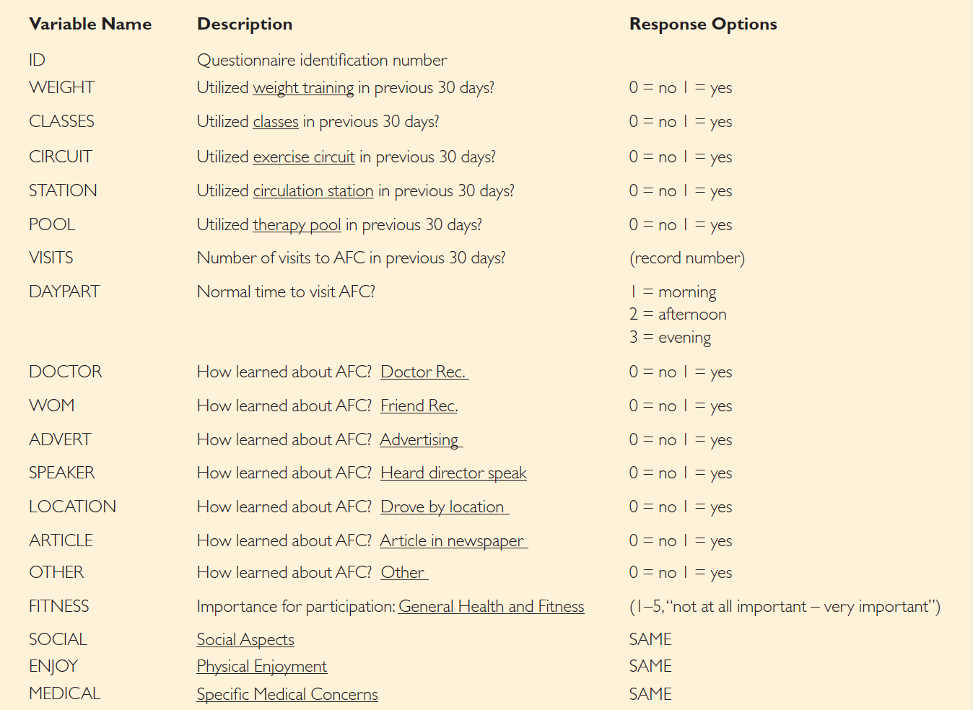
Codebook Example
Notes:
So this is a codebook example,

Slide 26
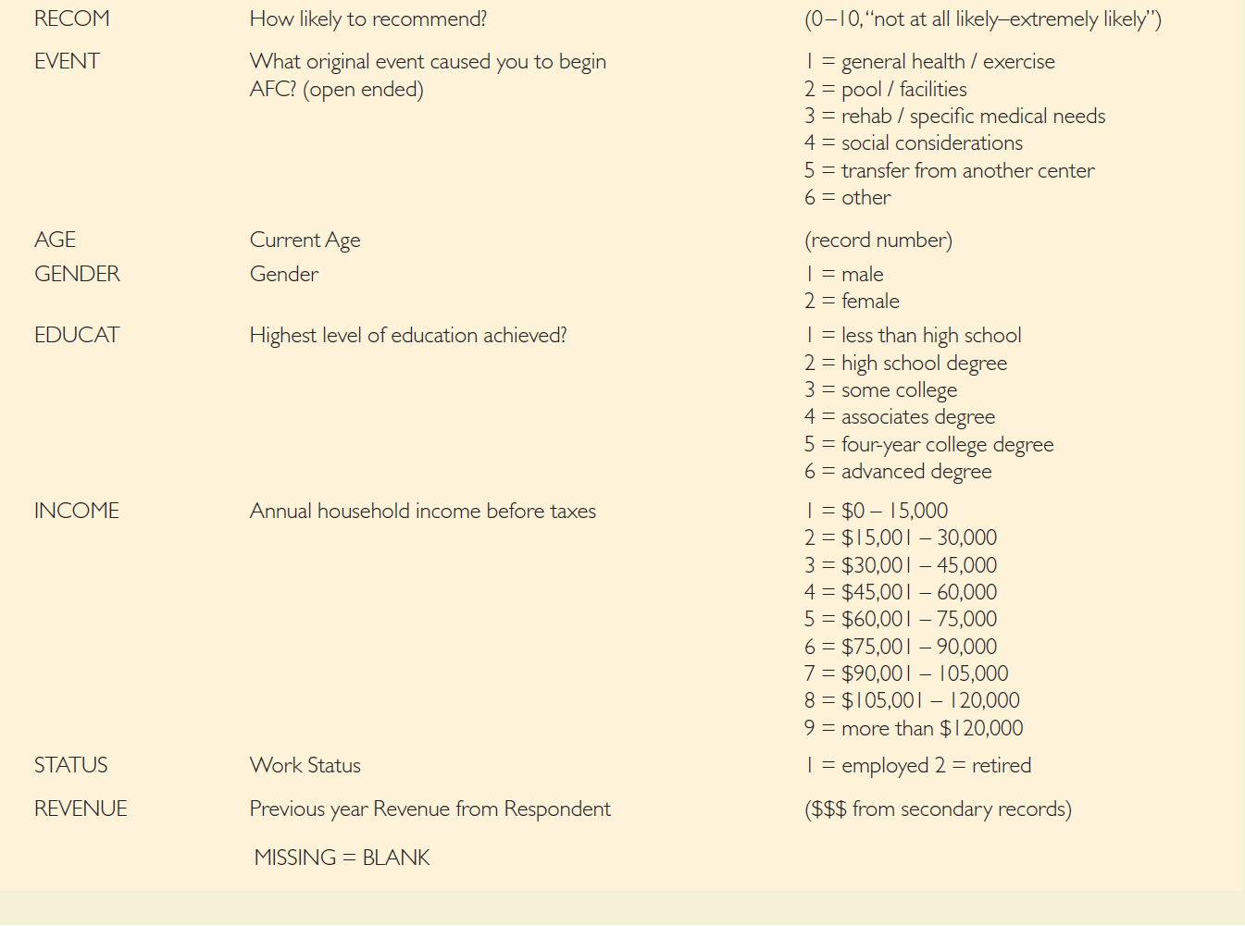
Codebook Example (cont.)

Slide 27

Group Discussion
How to collect data
Each team needs to have at least 200 responses.
Fabrication = 0 for the project!

Slide 28
Up Next
Week 8 Quiz
Start collecting data

Slide 29
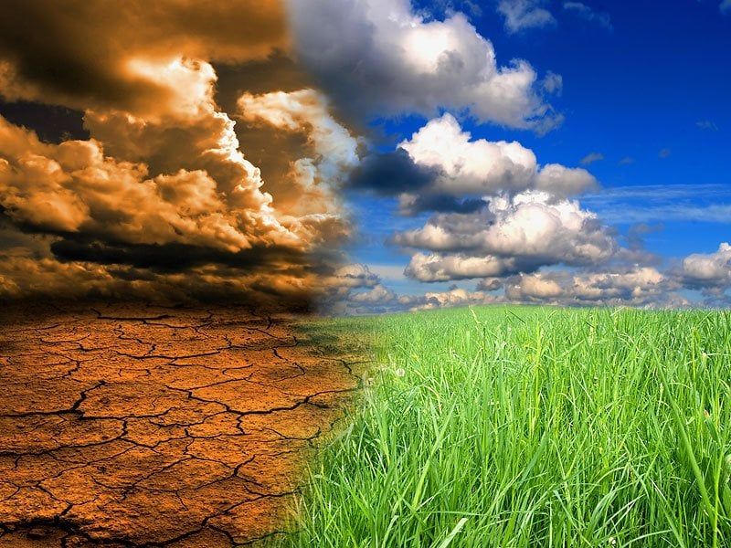
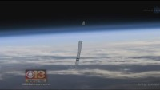
5-min snippet – Climate Change
Cloud
CO2
Notes:
This is a model of energy flow in the earth, particularly heat energy. It shows the earth as rose colored, and the surface of the planet is represented by a green strip. Above the strip there is a blue atmosphere and black space at the top. Clouds and carbon dioxide (CO2) molecules can be added to the atmosphere. The CO2 molecules represent greenhouse gases that block infrared light that is emitted by the earth. Clouds block incoming or outgoing sun rays, influencing the heating up or cooling down of the planet.
Yellow arrowheads stream downward representing sunlight energy. Some of the sunlight reflects off clouds and more can reflect off the earth's surface.
If sunlight is absorbed by the earth, it turns into a red dot, representing heat energy. Each dot represents the energy of one yellow sunlight arrowhead.
http://www.netlogoweb.org/launch#http://www.netlogoweb.org/assets/modelslib/Sample%20Models/Earth%20Science/Climate%20Change.nlogo
The red dots randomly move around the earth, and its temperature is related to the total number of red dots.
Sometimes the red dots transform themselves into infrared (IR) light that heads toward space, carrying off energy. The probability of a red dot becoming IR light depends on the earth's temperature.
When the earth is cold, few red dots generate IR light; when it is hot, most do. The IR energy is represented by a magenta arrowhead. Each carries the same energy as a yellow arrowhead and as a red dot. The IR light goes through clouds but can bounce off CO2 molecules.
There is a relation between the number of red dots in the earth and the temperature of the earth. This is because the earth temperature goes up as the total thermal energy is increased. Thermal energy is added by sunlight that reaches the earth as well as from infrared (IR) light reflected down to the earth. Thermal energy is removed by IR emitted by the earth. The balance of these determines the energy in the earth, which is proportional to its temperature.
There are, of course, many simplifications in this model. The earth is not a single temperature, does not have a single albedo, and does not have a single heat capacity. Visible light is somewhat absorbed by CO2 and some IR light does bounce off clouds. No model is completely accurate. What is important is that a model reacts in some ways like the system it is supposed to model. This model does that, showing how the greenhouse effect is caused by CO2 and other gases that absorb IR.
The ALBEDO slider controls how much of the sun energy hitting the earth is absorbed. If the albedo is 1.0, the earth reflects all sunlight. This could happen if the earth froze, and it is indicated by a white surface. If the albedo is zero, the earth absorbs all sunlight. This is indicated as a black surface. The earth's albedo is about 0.6.

